Slide 1

Group #2 Christopher Lin, Tyler Huey, Kaustuv Das, Shu Xu, Felix Yeung, Sagar Patel

Slide 2
The Heart Problem
Heart disease is in epidemic problem
600,000 people die in America each year
The importance of early treatment (heart attacks)
Cardiac tissue dies every second
Person often does not have the ability to call for help
Heartbiit’s Solution
Detect when a cardiac anomaly occurs
Alert emergency services automatically
Allow the user to receive quicker treatment

Slide 3
Heart Anomaly
Normal Resting Adult Human Heart(60-100 BPM)
Cardiac Arrhythmia
Bradycardia=Too Slow(<60 by American Heart Association standards)
Tachycardia=Too Fast(>100 by American Heart Association Standards)
Resting Heart Rate (Rest)
Awake
Neutrally Temperate Environment
Not active
Aerobic Exercising
Maximum Heart Rate Without Serious Problems
Target Heart Rate (65%-85% intensity)

Slide 4
Our Algorithm
Calculate Maximum Heart Rate
Average of Methods
Men = (Oakland + Robergs + Gellish)/3
Women = (Oakland + Robergs + Gulati)/3
Resting Analysis
± 20 Threshold
BPM > (AvgBPM + 20)
BPM < (AvgBPM – 20)
Exercising Analysis
BPM > HrMax
BPM < (HrMax*Intensity)
Lower limit determined by user (Below 65%)

Slide 5
Determining Maximum Heart Rate
Main Factors
Age
Gender
Oakland
HRMax = 191.5 – (0.007 x age^2)
Confidence Interval ±2 – 5 bpm
Robergs and Landwehr
HRMax = 205.8 – (0.685)*age
Least objectionable
Gulati (women)
HRMax = 203.7 – (0.88*age)
Gellish (men)
HRMax = 203.7/(1 + exp(0.033*(age – 104.3)))

Slide 6
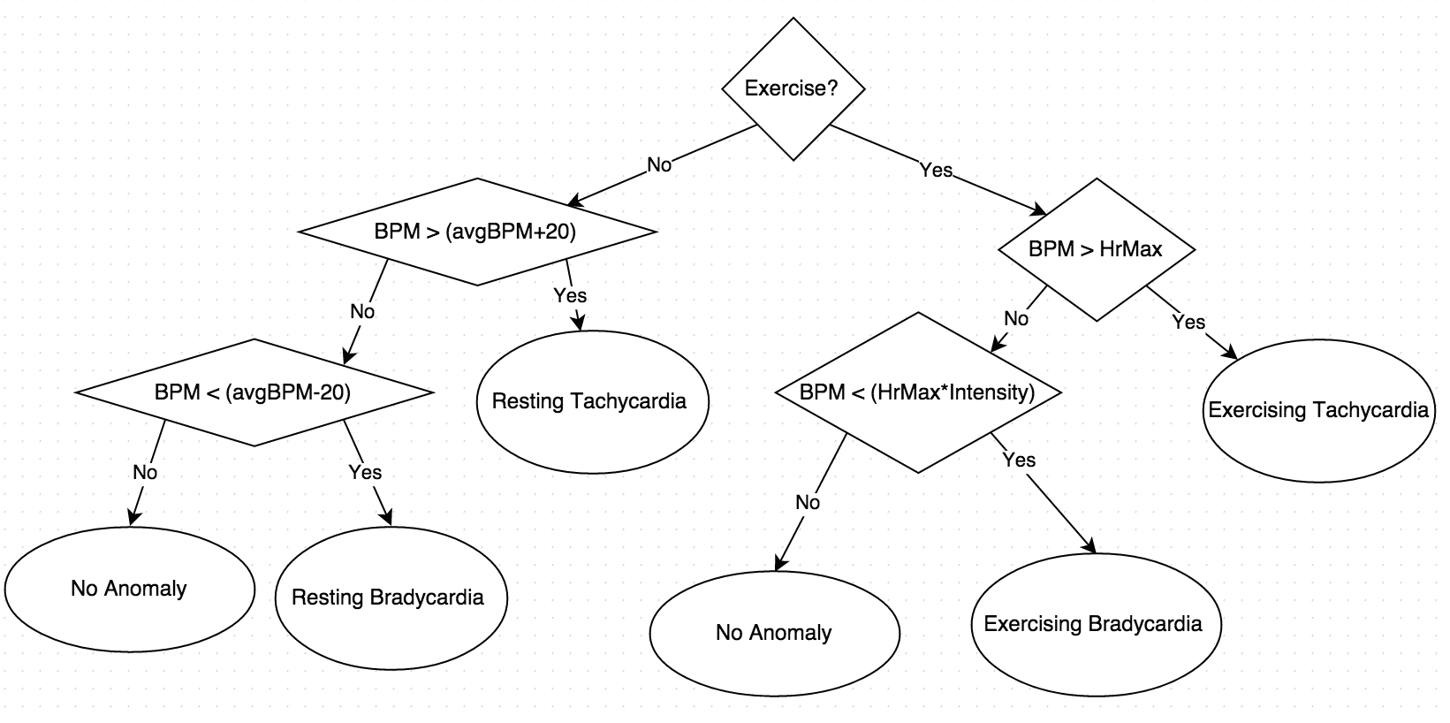
Algorithm Flow Control

Slide 7
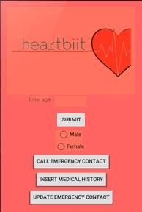
User Interface

Slide 8
Our Application at Present
Use Cases
Call Emergency Services
User Manually Terminates the Call
Determine GPS Location
Procedure
A heart rate anomaly is detected
Application waits 10 seconds for the user to manually terminate the call
If user does not terminate call
Phone call is successfully made
If user does terminate the call
No phone call is made
Send designated recipient GPS location via text

Slide 9
Goals for Next Demo
Develop Website http://tylerjameshuey1.wix.com/heartbiit
Sync Fitbit to Phone
Research Different Anomalies
Polish User Interphase
More Inputs
Medical History
Set Prescription Alarms

